Slide 1
ML Methods for Credit Card Fraud Identification
Brandon Cook, Cason Wight, and Mitchell Wassom

Slide 2
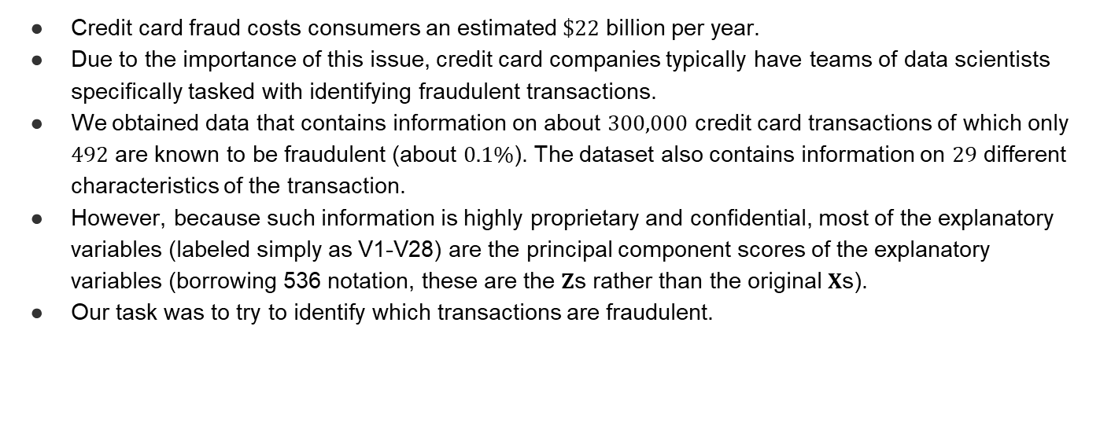
Background
Credit card fraud costs consumers an estimated $\$22$ billion per year.
Due to the importance of this issue, credit card companies typically have teams of data scientists specifically tasked with identifying fraudulent transactions.
We obtained data that contains information on about $300,000$ credit card transactions of which only $492$ are known to be fraudulent (about $0.1\%$). The dataset also contains information on $29$ different characteristics of the transaction.
However, because such information is highly proprietary and confidential, most of the explanatory variables (labeled simply as V1-V28) are the principal component scores of the explanatory variables (borrowing 536 notation, these are the $Z$s rather than the original $X$s).
Our task was to try to identify which transactions are fraudulent.

Slide 3
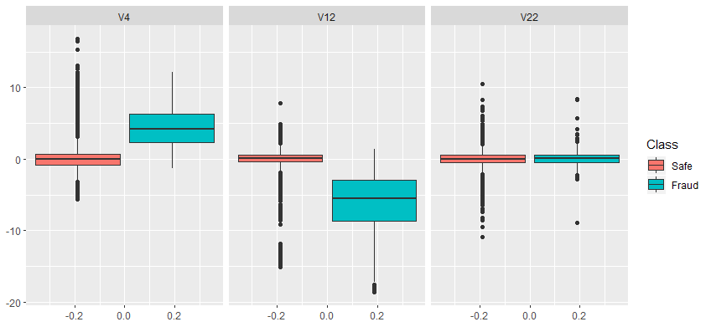
Data Visualization

Slide 4
Problems with Data
Small proportion of transactions are fraudulent
Classification for unbalanced classes can be unreliable
Fraud cases very similar to non-fraud cases
High variance
Meaningful inference impossible due to principal-component variables

Slide 5
Goals
Apply machine learning (ML) methods to explore credit card fraud
Classification Tree
K-nearest neighbors (KNN)
Neural Net
Assess prediction ability and “fit” of these three methods

Slide 6
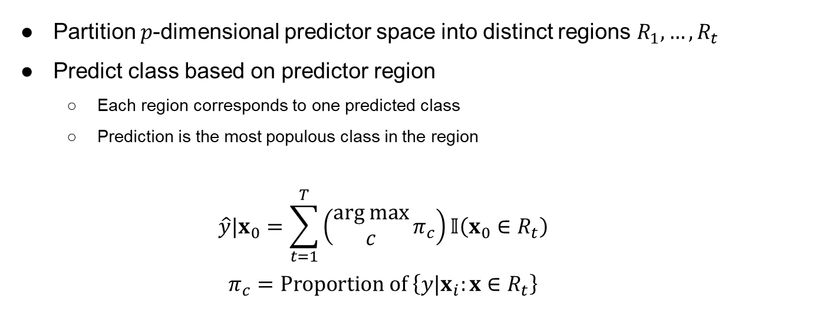
Classification Trees
Partition $p$-dimensional predictor space into distinct regions $R_{1},…,R_{t}$
Predict class based on predictor region
Each region corresponds to one predicted class
Prediction is the most populous class in the region
$$\hat{y}|x_{0}=\sum_{t=1}^{T}{\left(\begin{aligned}arg max \\ c\end{aligned}{π_{c}}\right)𝕀\left(x_{0}∈R_{t}\right)}$$
$$π_{c}=Proportion of \left\{y|x_{i}:x∈R_{t}\right\}$$

Slide 7
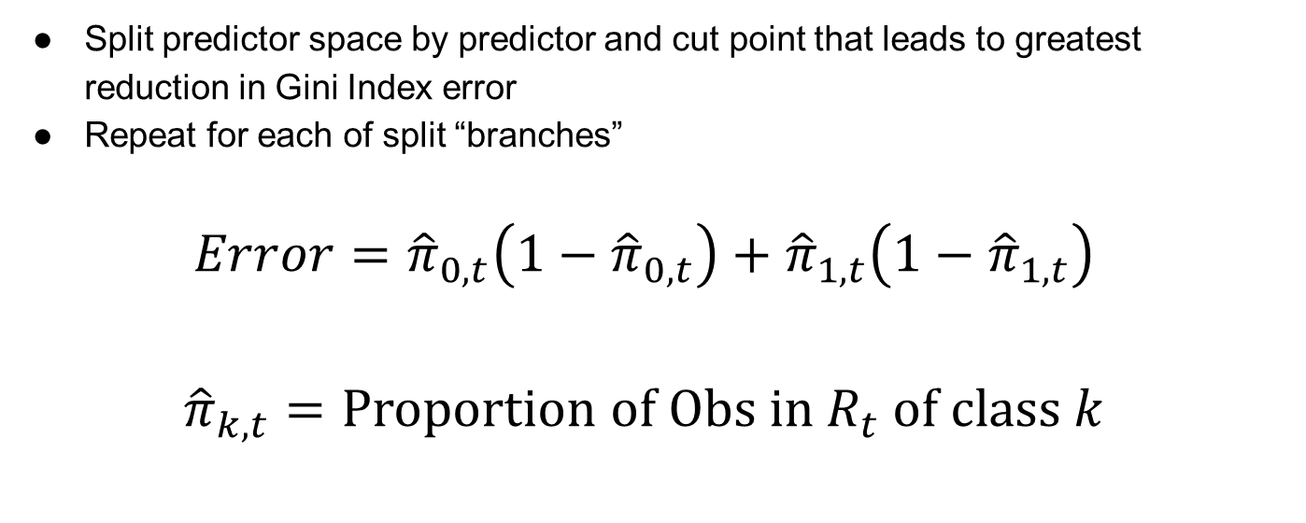
Classification Trees
Split predictor space by predictor and cut point that leads to greatest reduction in Gini Index error
Repeat for each of split “branches”
$$Error={\hat{π}}_{0,t}\left(1−{\hat{π}}_{0,t}\right)+{\hat{π}}_{1,t}\left(1−{\hat{π}}_{1,t}\right)$$
$${\hat{π}}_{k,t}=Proportion of Obs in R_{t} of class k$$

Slide 8
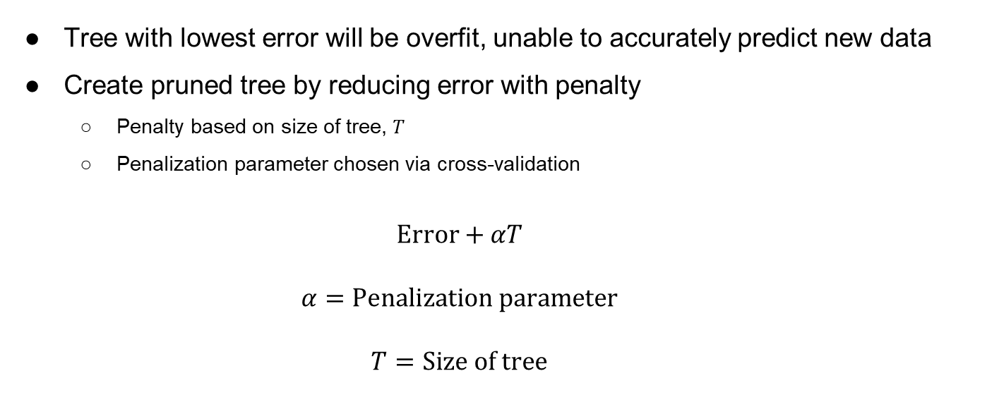
Classification Trees
Tree with lowest error will be overfit, unable to accurately predict new data
Create pruned tree by reducing error with penalty
Penalty based on size of tree, $T$
Penalization parameter chosen via cross-validation
$$Error+αT$$
$$α=Penalization parameter$$
$$T=Size of tree$$

Slide 9
Classification Trees
Weaknesses:
Homogeneity in regions lacks nuance
Difficult to detect unbalanced classes
No uncertainty for inference
Strengths:
Outputs probabilities
Decision tree is very interpretable

Slide 10
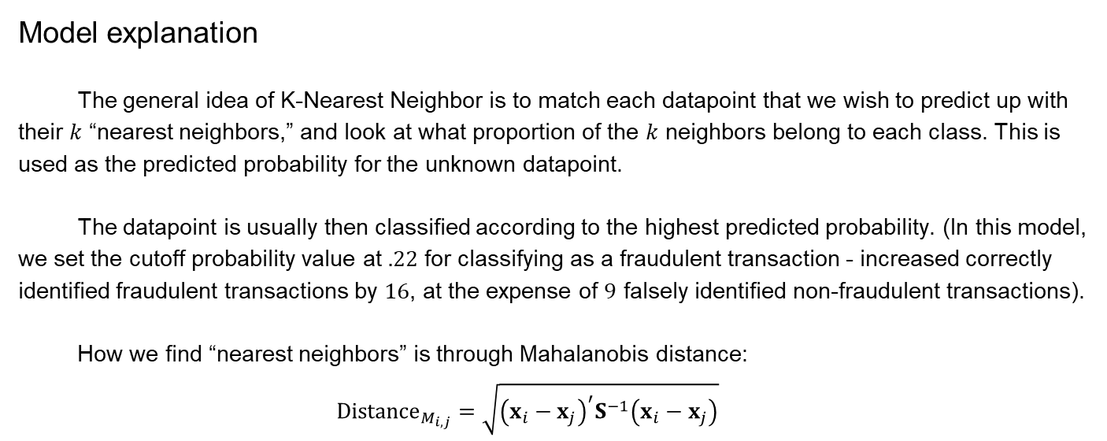
K-Nearest Neighbor
Model explanation
The general idea of K-Nearest Neighbor is to match each datapoint that we wish to predict up with their $k$ “nearest neighbors,” and look at what proportion of the $k$ neighbors belong to each class. This is used as the predicted probability for the unknown datapoint.
The datapoint is usually then classified according to the highest predicted probability. (In this model, we set the cutoff probability value at $.22$ for classifying as a fraudulent transaction - increased correctly identified fraudulent transactions by $16$, at the expense of $9$ falsely identified non-fraudulent transactions).
How we find “nearest neighbors” is through Mahalanobis distance:
$${Distance}_{M_{i,j}}=\sqrt{{\left(x_{i}−x_{j}\right)}^{′}S^{−1}\left(x_{i}−x_{j}\right)}$$

Slide 11
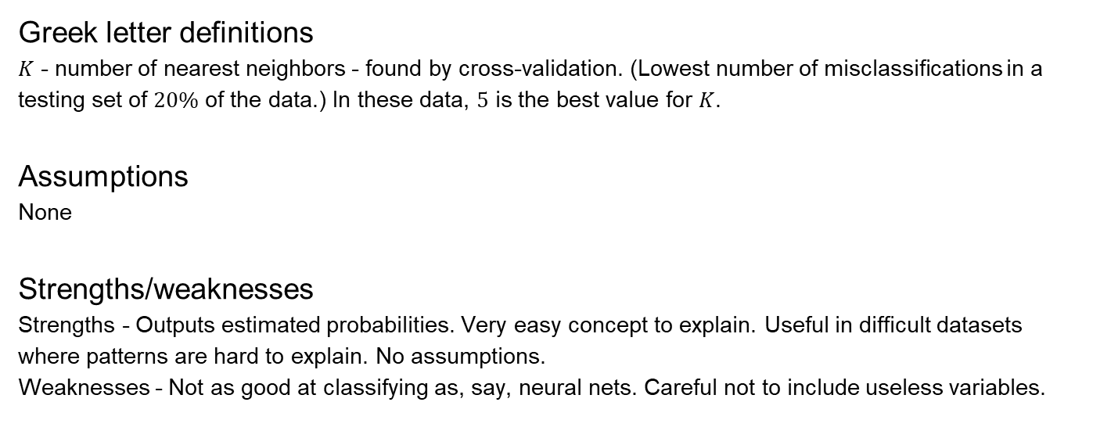
K Nearest Neighbor Cont.
Greek letter definitions
$K$ - number of nearest neighbors - found by cross-validation. (Lowest number of misclassifications in a testing set of $20\%$ of the data.) In these data, $5$ is the best value for $K$.
Assumptions
None
Strengths/weaknesses
Strengths - Outputs estimated probabilities. Very easy concept to explain. Useful in difficult datasets where patterns are hard to explain. No assumptions.
Weaknesses - Not as good at classifying as, say, neural nets. Careful not to include useless variables.

Slide 12
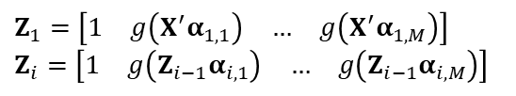
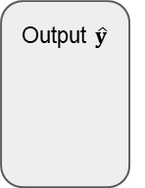
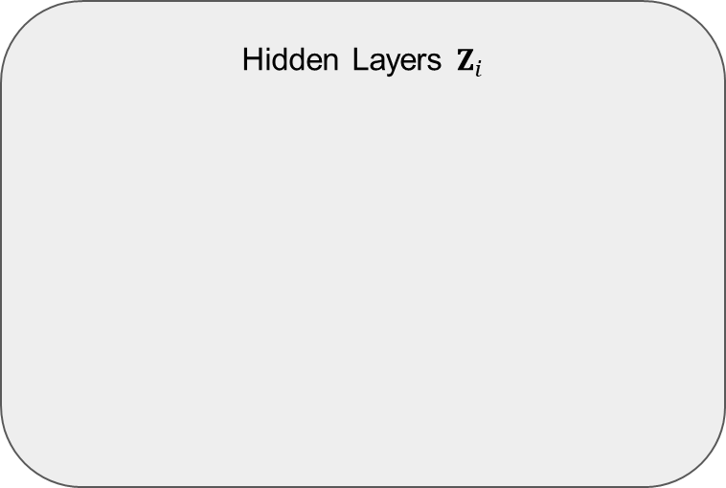
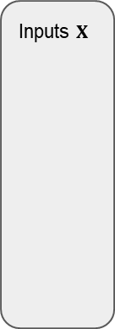
Neural Nets
Hidden Layers $Z_{i}$
Inputs $X$
$Z_{1}=\left[\begin{matrix}1 & g\left(X^{′}α_{1,1}\right) & … & g\left(X^{′}α_{1,M}\right)\end{matrix}\right]$
$Z_{i}=\left[\begin{matrix}1 & g\left(Z_{i−1}α_{i,1}\right) & … & g\left(Z_{i−1}α_{i,M}\right)\end{matrix}\right]$
Output $\hat{y}$
⋯
⋯
⋯
Neuron:
Activation:
$g\left(∙\right)$ is the activation function (many available–such as sigmoidal, hyperbolic, etc.)
$α_{i,m}$ are the weights for each input given in the previous layer for the $i^{th}$ layer on the $m^{th}$ neuron of the level

Slide 13
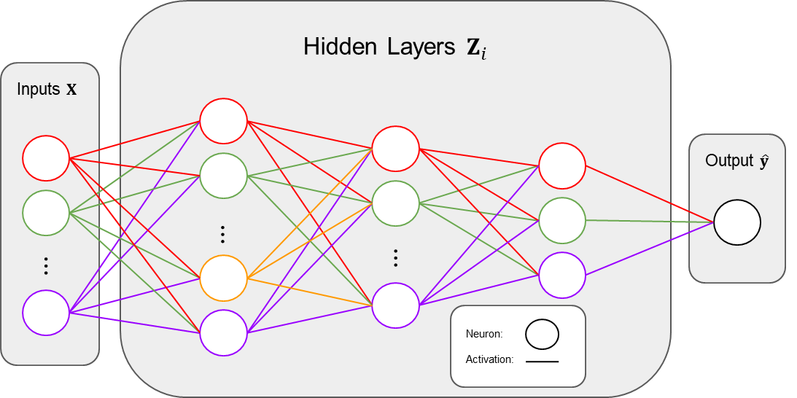
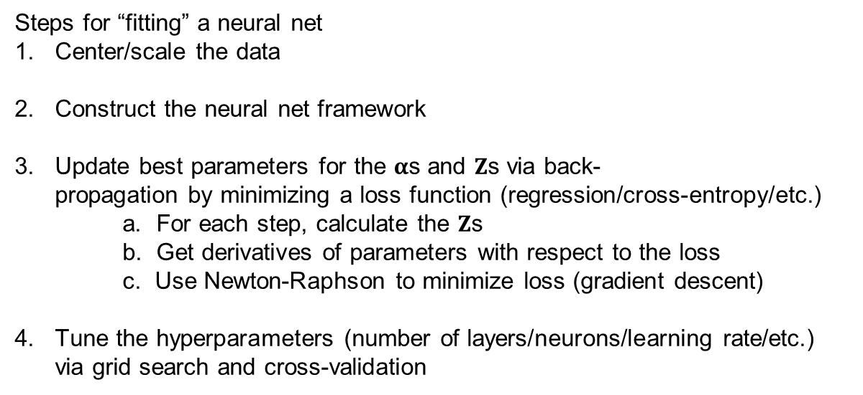
Neural Nets
Steps for “fitting” a neural net
Center/scale the data
Construct the neural net framework
Update best parameters for the $α$s and $Z$s via back-
propagation by minimizing a loss function (regression/cross-entropy/etc.)
a. For each step, calculate the $Z$s
b. Get derivatives of parameters with respect to the loss
c. Use Newton-Raphson to minimize loss (gradient descent)
Tune the hyperparameters (number of layers/neurons/learning rate/etc.)
via grid search and cross-validation

Slide 14
Neural Nets Cont.
Strengths:
Highly flexible (linear, nonlinear, categorical, etc.)
Can achieve excellent prediction
No assumptions of any type needed (not a model)
Weaknesses:
Inference is utterly impossible
Tuning is a major challenge
Computation time can be a burden

Slide 15
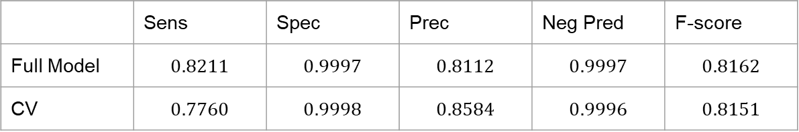
Classification Trees for Credit Card Fraud - Brandon
All variables included; Pruning determines which variables are most important
Pruning parameter chosen via cross-validation
Model with highest sensitivity chosen (thus AUC might be inferior)
Sensitivity prioritized because false negatives worse than false positives
 | Sens | Spec | Prec | Neg Pred | F-score
Full Model | $$0.8211$$ | $$0.9997$$ | $$0.8112$$ | $$0.9997$$ | $$0.8162$$
CV | $$0.7760$$ | $$0.9998$$ | $$0.8584$$ | $$0.9996$$ | $$0.8151$$

Slide 16
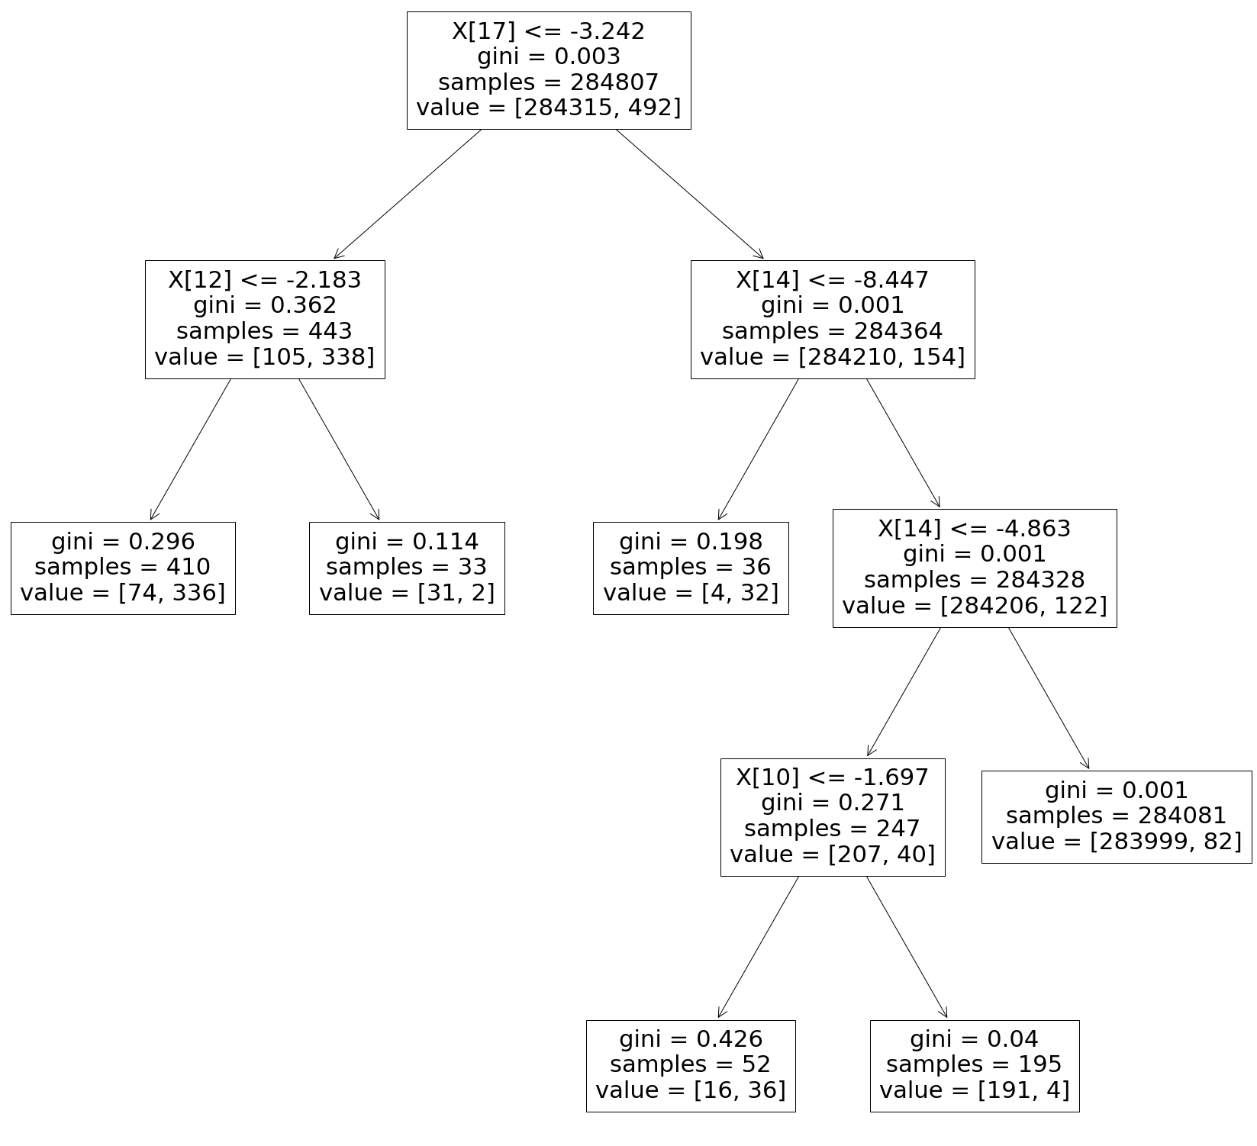
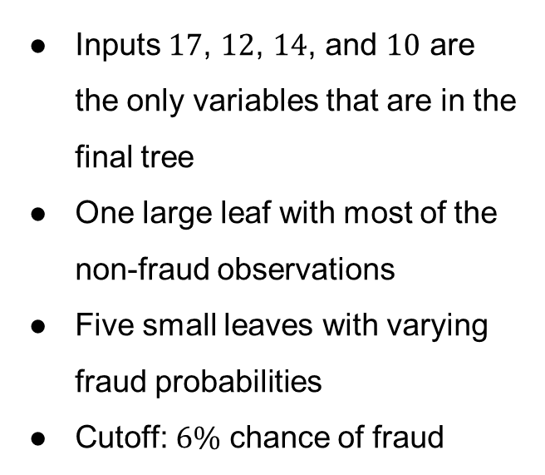
Classification Tree
Inputs $17$, $12$, $14$, and $10$ are the only variables that are in the final tree
One large leaf with most of the non-fraud observations
Five small leaves with varying fraud probabilities
Cutoff: $6\%$ chance of fraud

Slide 17
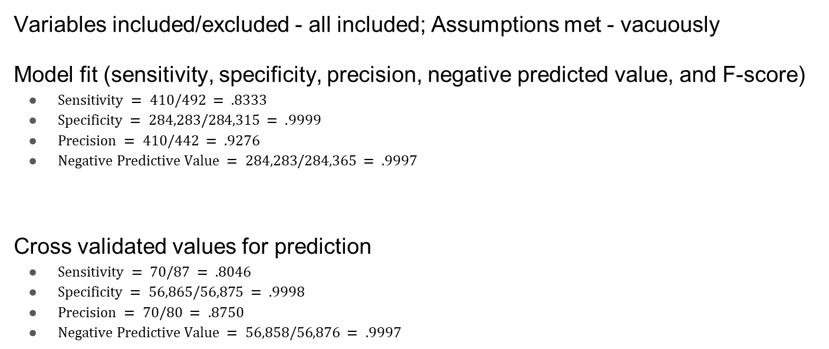
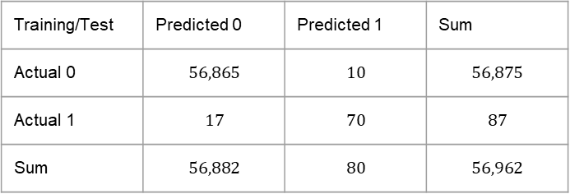
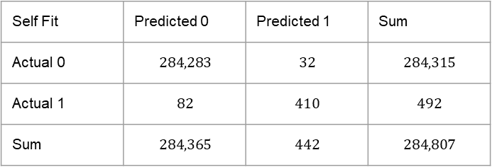
K-Nearest Neighbors for Credit Card Fraud - Mitch
Variables included/excluded - all included; Assumptions met - vacuously
Model fit (sensitivity, specificity, precision, negative predicted value, and F-score)
$Sensitivity = 410/492 = .8333$
$Specificity = 284,283/284,315 = .9999$
$Precision = 410/442 = .9276$
$Negative Predictive Value = 284,283/284,365 = .9997$
Cross validated values for prediction
$Sensitivity = 70/87 = .8046$
$Specificity = 56,865/56,875 = .9998$
$Precision = 70/80 = .8750$
$Negative Predictive Value = 56,858/56,876 = .9997$
Self Fit | Predicted 0 | Predicted 1 | Sum
Actual 0 | $$284,283$$ | $$32$$ | $$284,315$$
Actual 1 | $$82$$ | $$410$$ | $$492$$
Sum | $$284,365$$ | $$442$$ | $$284,807$$
Training/Test | Predicted 0 | Predicted 1 | Sum
Actual 0 | $$56,865$$ | $$10$$ | $$56,875$$
Actual 1 | $$17$$ | $$70$$ | $$87$$
Sum | $$56,882$$ | $$80$$ | $$56,962$$

Slide 18
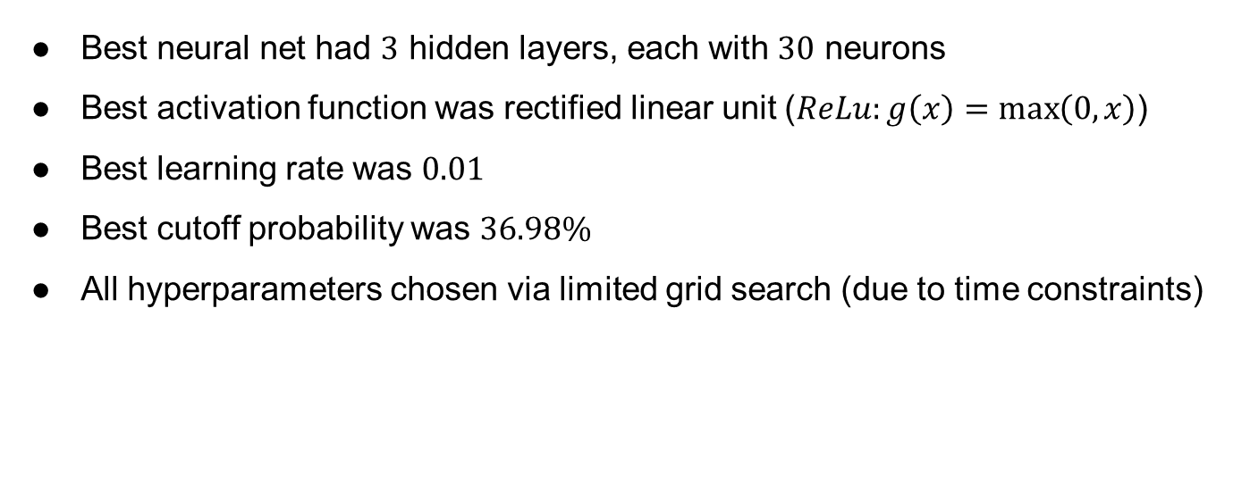
Neural Net for Credit Card Fraud
Best neural net had $3$ hidden layers, each with $30$ neurons
Best activation function was rectified linear unit ($ReLu:g\left(x\right)=\max\left(0,x\right)$)
Best learning rate was $0.01$
Best cutoff probability was $36.98\%$
All hyperparameters chosen via limited grid search (due to time constraints)
 | Sens | Spec | Prec | Neg Pred | F-score
Full Model | 0.8272 | 0.9999 | 0.9667 | 0.9997 | 0.8904
CV | 0.8627 | 0.9997 | 0.8381 | 0.9998 | 0.8502

Slide 19
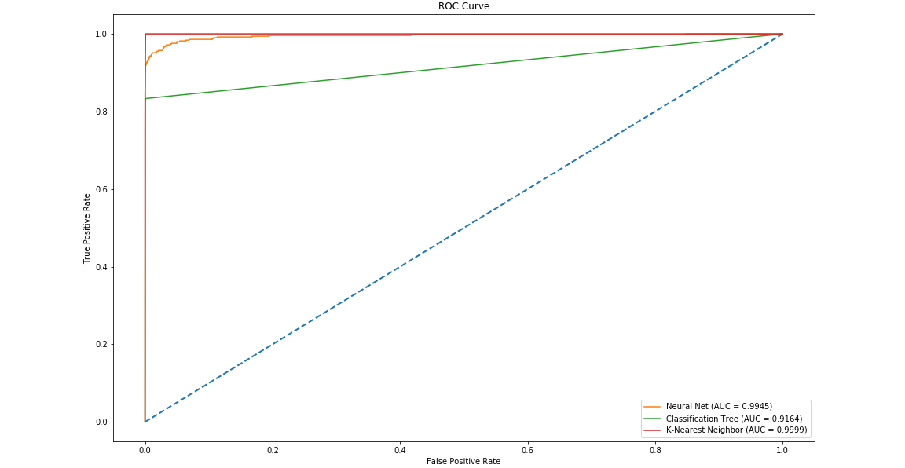
ROC curves and AUC

Slide 20
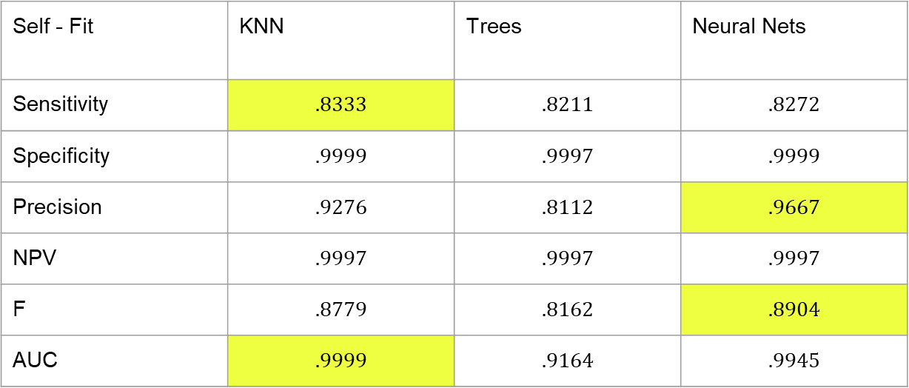
Summary of Results - Self Fit
Self - Fit | KNN | Trees | Neural Nets
Sensitivity | $$.8333$$ | $$.8211$$ | $$.8272$$
Specificity | $$.9999$$ | $$.9997$$ | $$.9999$$
Precision | $$.9276$$ | $$.8112$$ | $$.9667$$
NPV | $$.9997$$ | $$.9997$$ | $$.9997$$
F | $$.8779$$ | $$.8162$$ | $$.8904$$
AUC | $$.9999$$ | $$.9164$$ | $$.9945$$

Slide 21
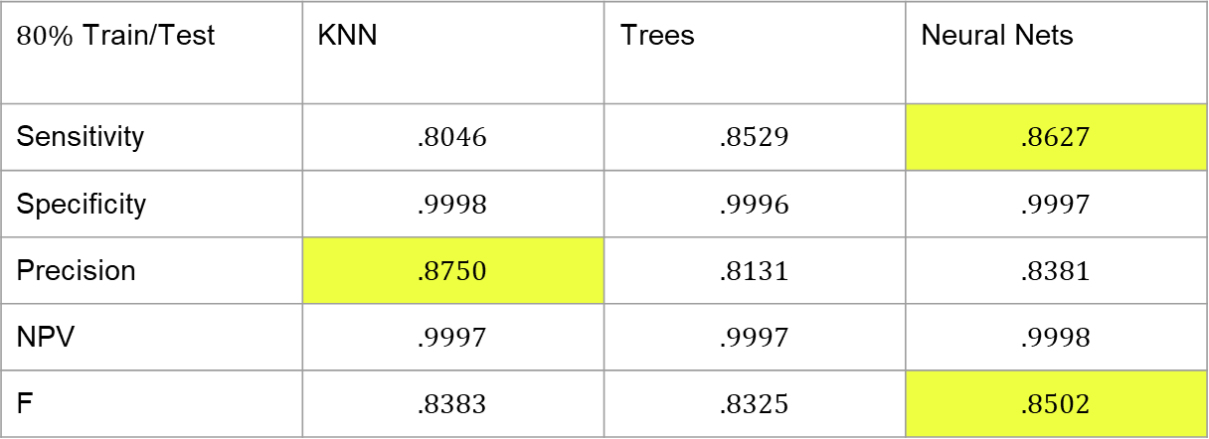
Predictions - Testing / Training Set
$80\%$ Train/Test | KNN | Trees | Neural Nets
Sensitivity | $$.8046$$ | $$.8529$$ | $$.8627$$
Specificity | $$.9998$$ | $$.9996$$ | $$.9997$$
Precision | $$.8750$$ | $$.8131$$ | $$.8381$$
NPV | $$.9997$$ | $$.9997$$ | $$.9998$$
F | $$.8383$$ | $$.8325$$ | $$.8502$$

Slide 22
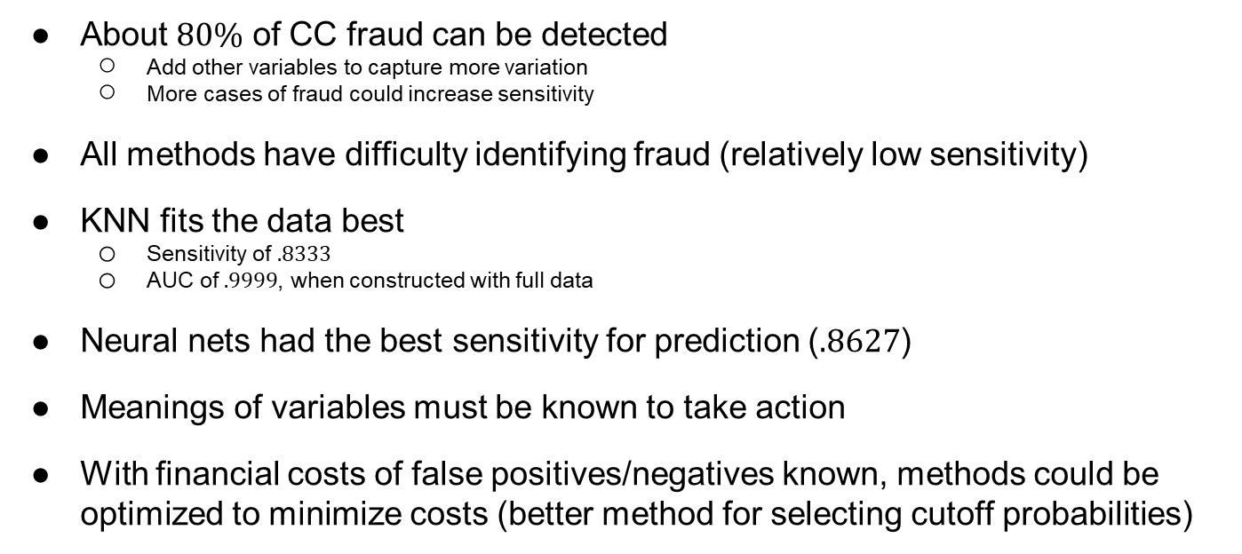
Conclusion
About $80\%$ of CC fraud can be detected
Add other variables to capture more variation
More cases of fraud could increase sensitivity
All methods have difficulty identifying fraud (relatively low sensitivity)
KNN fits the data best
Sensitivity of $.8333$
AUC of $.9999$, when constructed with full data
Neural nets had the best sensitivity for prediction ($.8627$)
Meanings of variables must be known to take action
With financial costs of false positives/negatives known, methods could be optimized to minimize costs (better method for selecting cutoff probabilities)

Slide 23
Teamwork
Introduction, KNN, Summary of Results - Mitchell
Data visualization/issues, CT, Conclusion - Brandon
Model fit and prediction ability, NN, Goals/Outline - Cason

